Slide 1
Gene regulation and chromatin states
Course Director
Yoav Gilad
Human Genetics department
CLSC room 325C
Phone: 773-702-8507
Email: gilad@uchicago.edu
Teaching Assistant
Katie Rhodes: klrhodes@uchicago.edu
Lecturer
Sebastian Pott: spott@uchicago.edu

Slide 2
Outline
Chromatin and genome organisation
Chromatin states
Conservation of chromatin organization
Sequence specific TFs influence chromatin marks

Slide 3
The DNA is shared across all cells within an individual

Slide 4
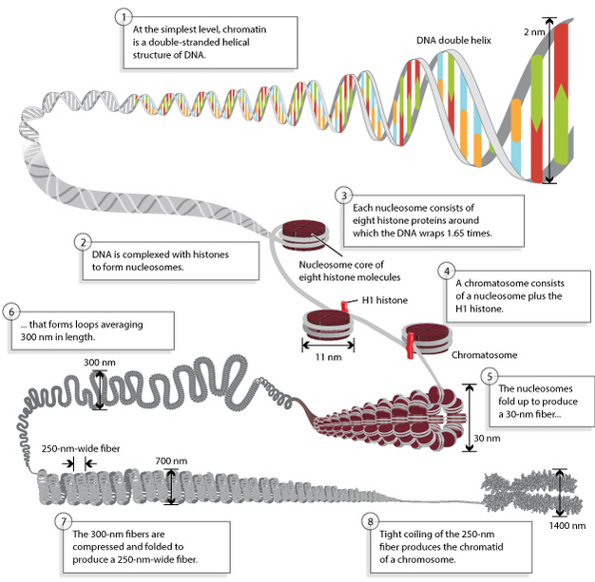
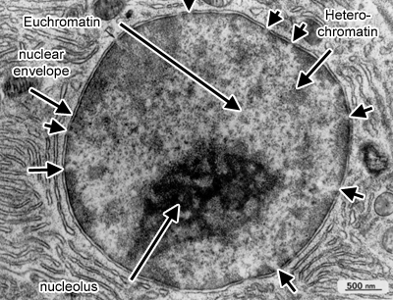
Primary genome sequenced is packaged into chromatin
http://www.histology.leeds.ac.uk/cell/nucleus.php
http://www.nature.com/scitable/topicpage/dna-packaging-nucleosomes-and-chromatin-310

Slide 5
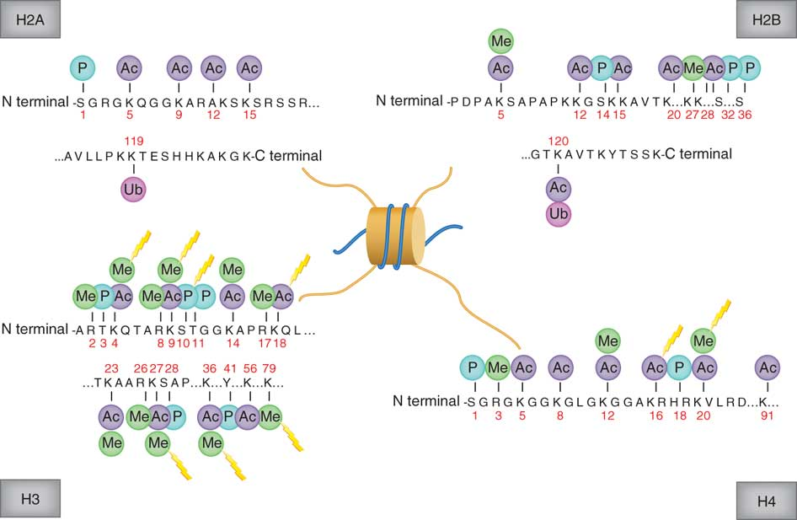
Nucleosome histone tails can be post-translationally modified
(Rodriguez-Paredes, Nat. Med., 2011)
Notes:
Two of each of these to make a total of eight
Most of the histone modifications are on histone tails of H3 historically, it is the most well-known
But a lot of these are redundant on the other histone

Slide 6
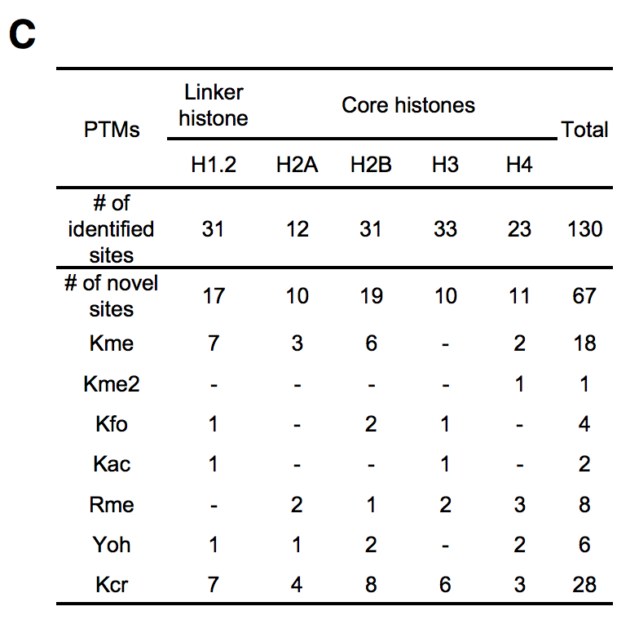
More than 100 known Histone modifications
(Kme) lysine monomethylation
(Kme2) lysine dimethylation
(Kfo) lysine formylation
(Kac) lysine acetylation
(Rme) arginine monomethylation
(Yoh) tyrosine hydroxylation
(Kcr) lysine crotonylation
(Tan, Cell, 2011)

Slide 7
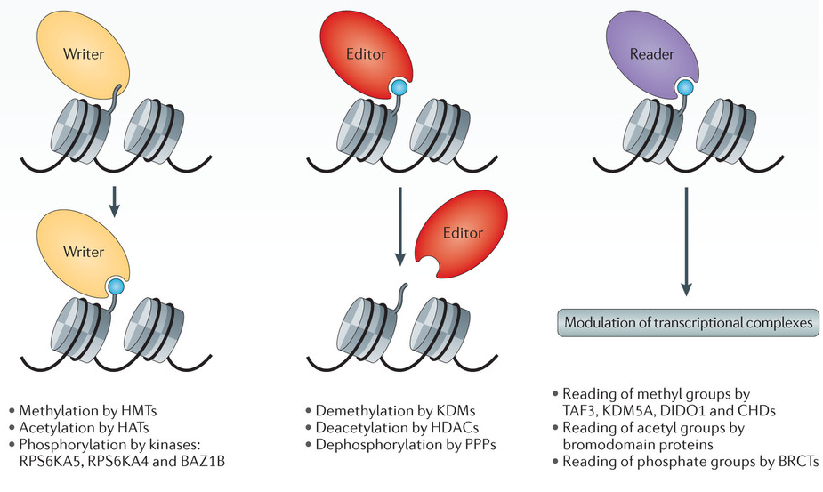
Histones are reversibly modified by ‘readers’, ‘writers’ and ‘erasers’
(Plass, Nat. Rev. Gen., 2013)

Slide 8
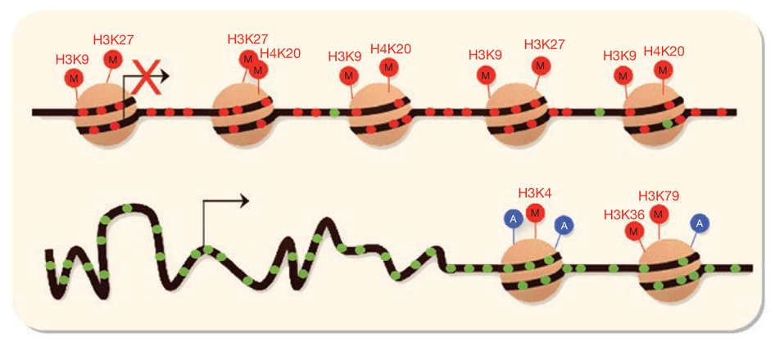
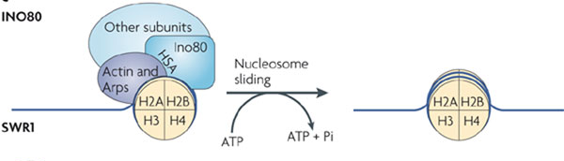
Nucleosome positioning modified by ATP-dependent chromatin-remodelling complexes
(Potela/Esellar, Nat. Biotech., 2010)
(Morrison/Shen, Nat. Rev. Mol. Cell Biol., 2009)
Notes:
Slide the histones along allow more areas to be expose while others are more compact
They can also be removed

Slide 9
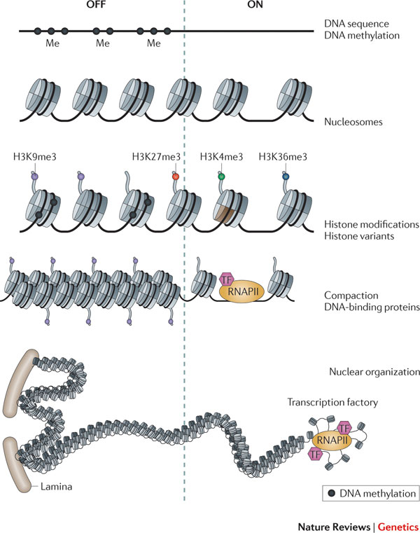
High and low transcriptional activity is associated with distinct chromatin organization
(Zhou, Nat. Rev. Gen., 2011)
Notes:
It is possible that TF specifically interact with DNA modifications (this is still controversial)

Slide 10
Activity and location-dependent chromatin modification
Shen and Laird, Cell, 2013
Notes:
NDR = nucleosome depleted region, usually near TSS
Meth on the gene body facilitates splicing by limiting splicing events via compaction

Slide 11
Combinatorial patterns of chromatin modifications around genes
(Barth and Imhof, TiBS, 2010)

Slide 12
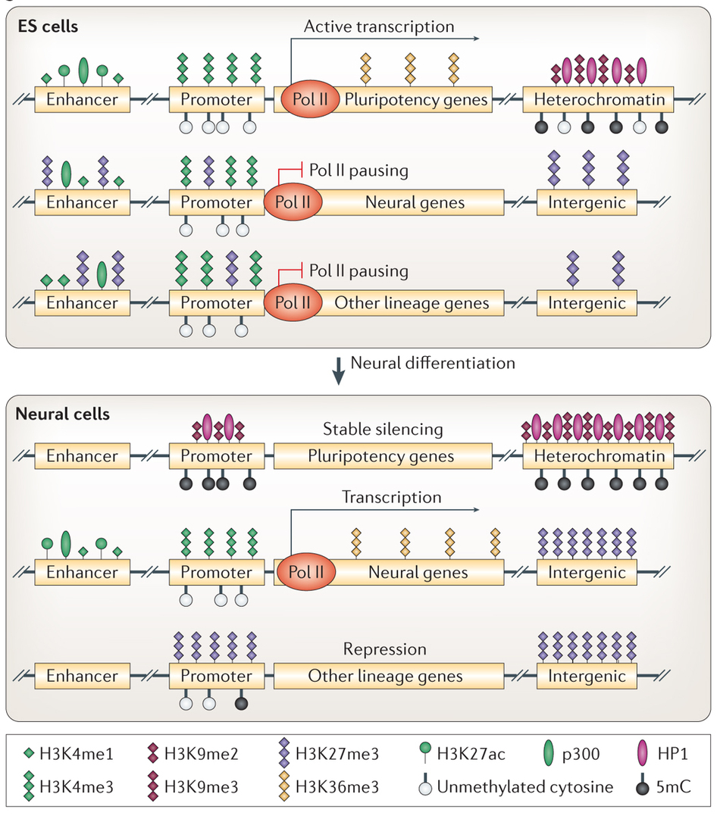
Tissue-specific patterns of chromatin organization
(Chen, Nat. Rev. Gen., 2014)

Slide 13
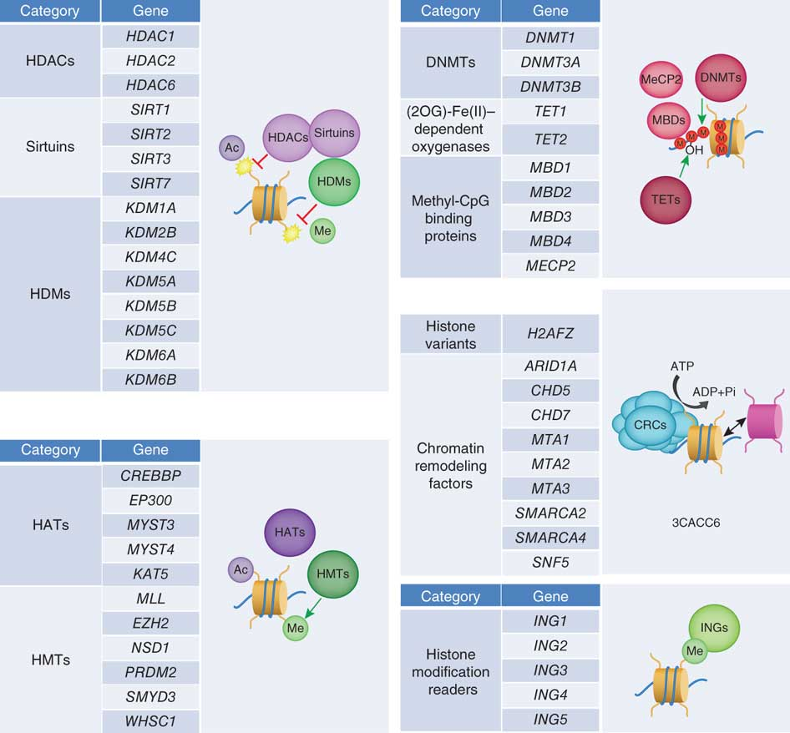
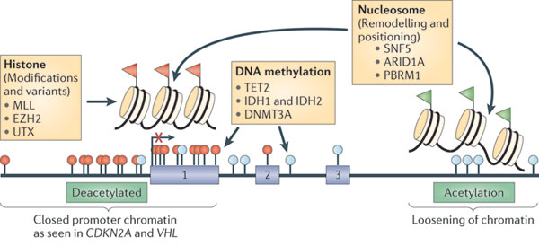
Chromatin modifiers are frequently mutated in cancer
(Rodriguez-Paredes, Nat. Med., 2011)
(Baylin/Jones, Nat. Rev. Cancer, 2011)

Slide 14
Chromatin modifiers are frequently mutated in cancer
(Shen and Laird, Cell, 2013)

Slide 15
How are regulatory elements and different chromatin states identified?

Slide 16
Re-cap: ChIP-seq
Step 1
Step 2
Step 3
Step 4

Slide 17
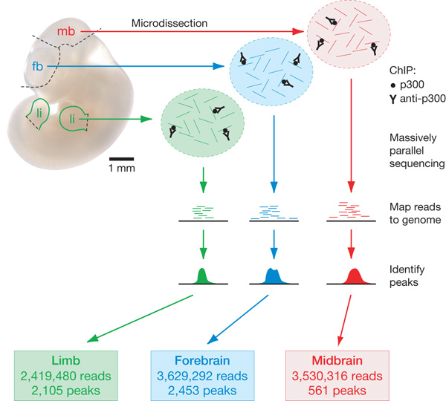
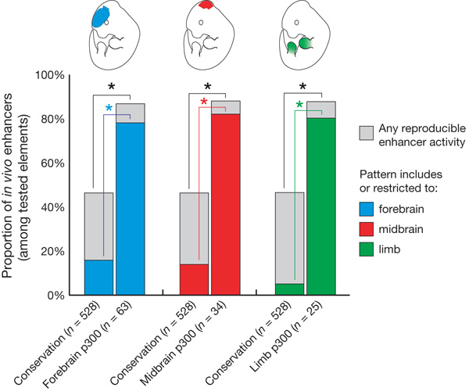
ChIP-seq of p300 HAT binding locations identifies enhancers
ChIP-seq accurately predicts tissue-specific activity of enhancers
(Visel, Nature, 2009)

Slide 18
Genome-wide maps of chromatin state in pluripotent and lineage-committed cells
(Mikkelsen, Nature, 2007)

Slide 19
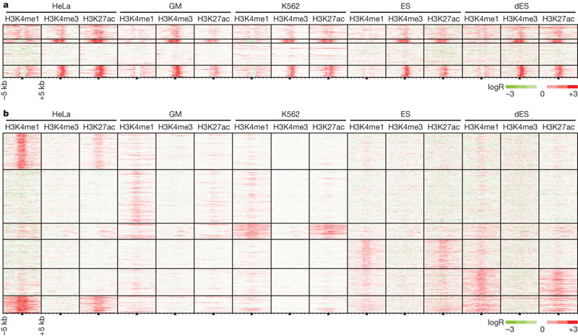
Chromatin modifications at promoters are cell type invariant while those at enhancers are cell type-specific
Promoters
Enhancers
(Heintzman , Nature, 2009)

Slide 20
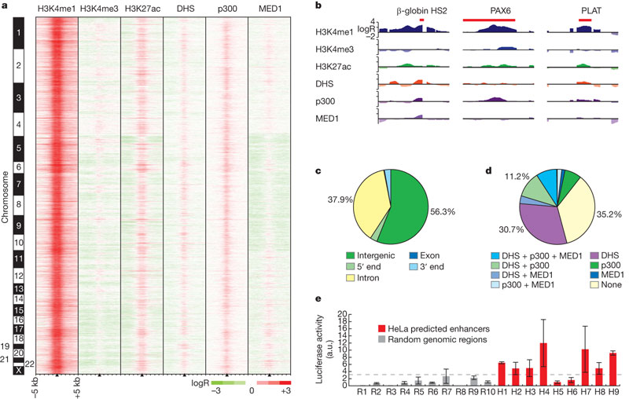
Genome-wide prediction of enhancers based on chromatin marks
(Heintzman , Nature, 2009)

Slide 21
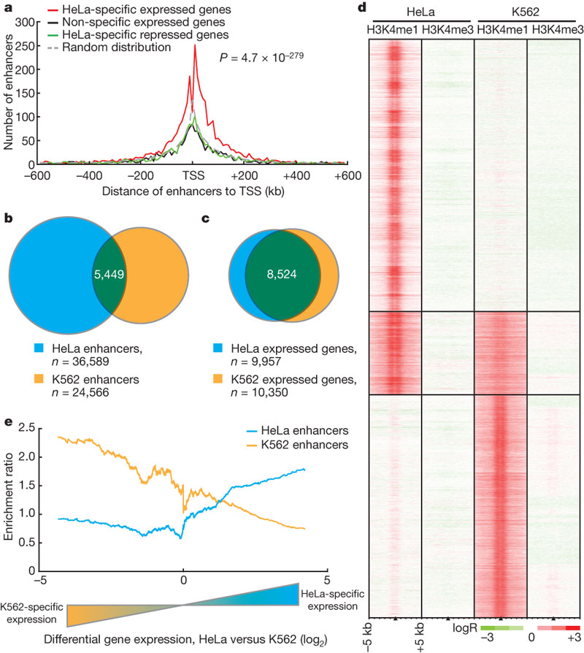
Chromatin modifications at enhancers are globally related to cell type-specific gene expression
(Heintzman, Nature, 2009)
Notes:
Hypothesis: same genes are being expressed at same levels, but with different mechanisms
Hypothesis: enahnacer are modulators of the expression

Slide 22
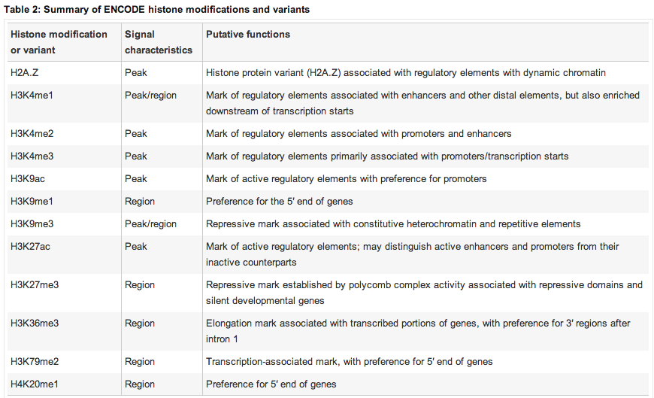
Histone modifications mark genomic features
(ENCODE Consortium, Nature, 2012)

Slide 23
Chromatin states

Slide 24
Classification of genomic regions into chromatin states
9 human cell types:
H1 ES (embryonic stem cells)
K562 (leukemia cell line)
GM (B-lymphoblastoid)
HepG2 (hepatocellular cancer)
HUVEC (umbilical vein endothelial cells)
HSMM (skeletal muscle myoblasts)
NHLF (lung fibroblasts)
NHEK (epidermal keratinocytes)
HMEC (mammary epithelial cells)
9 chromatin marks:
H3K4me3 (promoters)
H3K4me2 (promoters and enhancers)
H3K4me1 (enhancers)
H3K9ac (active regulatory regions)
H3K27ac (active regulatory regions)
H3K36me3 (transcribed regions)
H4K20me1 (transcribed regions)
H3K27me3 (repressed regions)
CTCF (insulator protein)
systematically characterize:
regulatory elements, their cell-type specificities and their functional interactions
Mapping and analysis of chromatin state dynamics in 9 human cell types
We want to identify chromatin states – labelling problem
(Ernst, Nature, 2011)

Slide 25
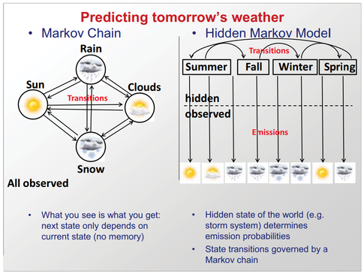
Markov Chain vs Hidden Markov models
(Manolis Kellis, Computational Biology Course, MIT)

Slide 26
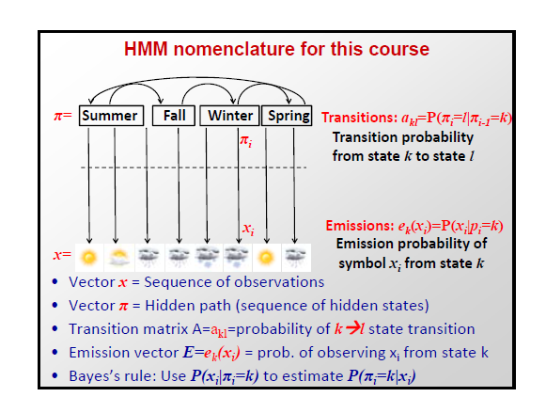
Hidden Markov model
(Manolis Kellis, Computational Biology Course, MIT)

Slide 27
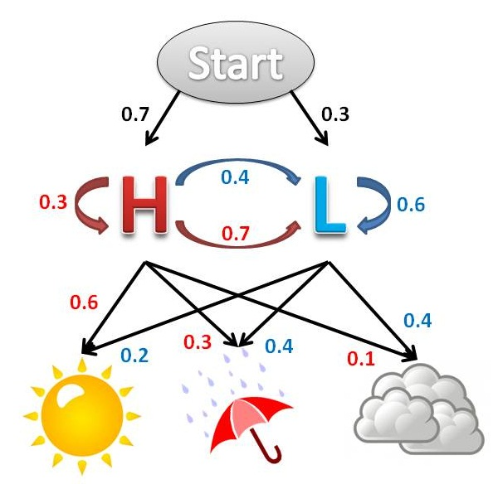
Hidden Markov model example
We want to know if there’s high or low pressure, but we can only observe whether it’s sunny, cloudy, or rainy:
red: probability of high pressure state given observed variables
blue: probability of low pressure state given observed variables
http://guizzetti.ca/blogs/lenny/2012/04/predicting-the-weather-with-hidden-markov-models/

Slide 28
Hidden Markov model genomics example
We want to know the chromatin state of genomic region but we only have histone modification information:
DNA
red: probability of DNA sequence being x given strongest observation of H3K27me3
blue: probability of DNA sequence being y given strongest observation of H3K27me1 & H3K27ac
H3K27me3
H3K27ac
H3K4me1
HMM formal foundation for probabilistic models of
linear sequence labelling problems
Notes:
Use histone marks to predict chromatin state/function

Slide 29
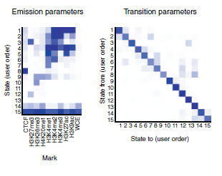
ChromHMM: algorithm for defining chromatin states
ChromHMM is software for learning and characterizing chromatin states. ChromHMM can integrate multiple chromatin datasets such as ChIP-seq data of various histone modifications to discover de novo the major re-occuring combinatorial and spatial patterns of marks. ChromHMM is based on a multivariate Hidden Markov Model that explicitly models the presence or absence of each chromatin mark. The resulting model can then be used to systematically annotate a genome in one or more cell types. By automatically computing state enrichments for large-scale functional and annotation datasets ChromHMM facilitates the biological characterization of each state.
Emission probabilities –histone mark observations
Transition probabilities- how chromatin states are distributed spatially across genome
(Ernst, Nat. Methods, 2012)

Slide 30
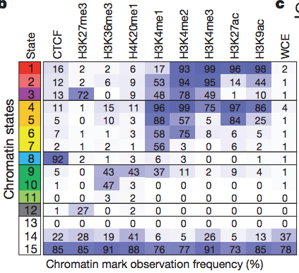
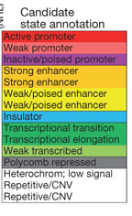
chromHMM identifies chromatin states in cell lines
(Ernst, Nature, 2011)

Slide 31
chromHMM identifies distinct chromatin states for different cell lines

Slide 32
Large scale mapping of chromatin states in 111 cell lines
‘To elucidate how epigenetic processes contribute to human biology & disease’
Resource of epigenomic data:
- characterise epigenomic landscape of representative primary human tissues and cells
Proposed biological insights:
- identify epigenome differences during lineage specification & differentiation
- recognise regions with coordinated activity across cell types (modules)
- identify key regulators of modules based on motif enrichments
- associate epigenomic annotation with disease-associated genetic variants

Slide 33
Primary tissue samples used by Roadmap epigenomics project

Slide 34
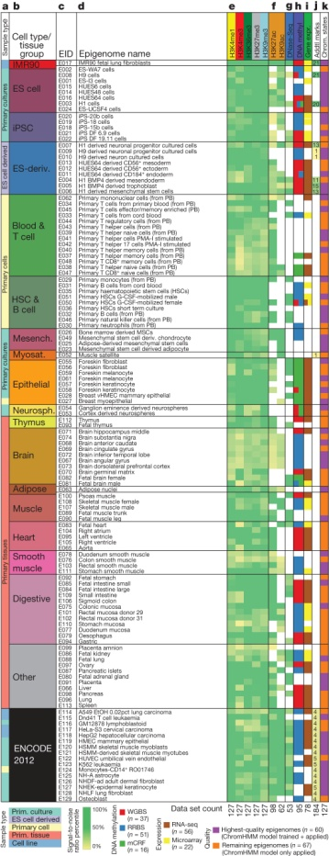
Data generated by Roadmap epigenomics project
4 data types:
‘111 Epigenomes’:
- ChIP-seq 5 histone modifications:
-promoters - H3K4me3
-enhancers - H3K4me1
-transcribed regions - H3K36me3
-polycomb repression - H3K27me3
-heterochromatin - H3K9me3
-enhancer/promoter – H3K9ac, H3K27ac
+ 16 ENCODE epigenomes
Chromatin accessibility:
-DNase-I seq
Repressed regulatory regions/active transcripts:
DNA methylation
-WGBS
-RRBS
-MRE
-MeDIP
Gene expression:
-RNA-seq
-microarrays
18 cell types:
-Primary cell types
adult + fetal
-ESCs, iPSCs, ESC-derived
-Primary cultures
(Kundaje, Nature, 2015)

Slide 35
Chromatin states in primary human tissues
(Kundaje, Nature, 2015)

Slide 36
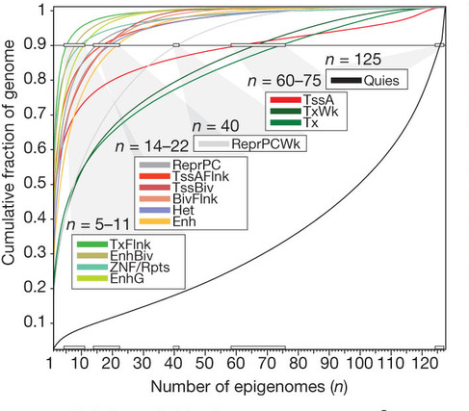
Different chromatin states vary in their tissue specificity
Consistency of each chromatin state across all 127 epigenomes
(5 histone marks/cell type)
(Kundaje, Nature, 2015)
Notes:
Areas that have a high degree of histone modification are often regions that are differentially expressed between tissues
These marks are also very highly conserved in function per tissue type in different eurkaryotes

Slide 37
Conservation of chromatin organization

Slide 38
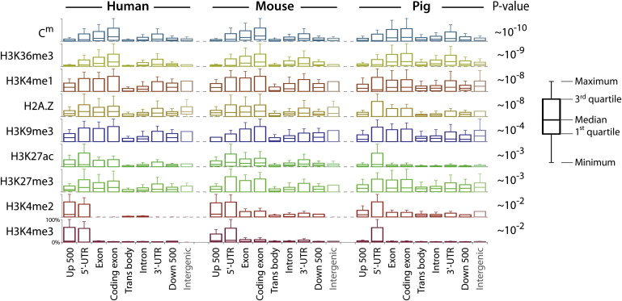
Association between histone modifications and genome annotations is largely conserved
Comparative Epigenomic Annotation of Regulatory DNA
(Xiao, Cell, 2012)

Slide 39
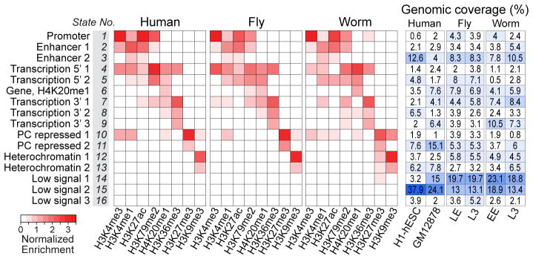
Combinatorial patterns of histone modifications are largely conserved
(modENCODE)
(Ho/Jung,/Liu, Nature, 2014)

Slide 40
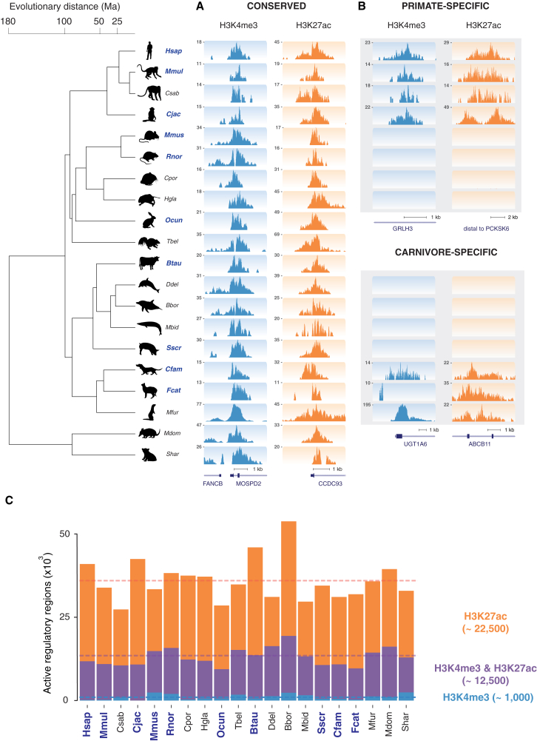
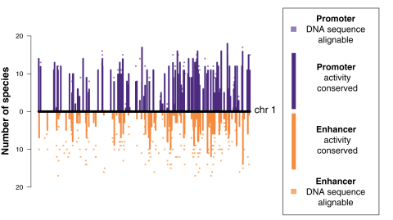
Histone modifications provide insight into promoter and enhancer evolution
Enhancer Evolution across 20 Mammalian Species
(Villar/Berthelot, Cell, 2015)
Notes:
Promoter

Slide 41
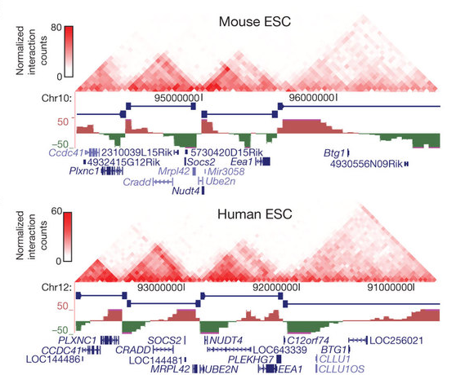
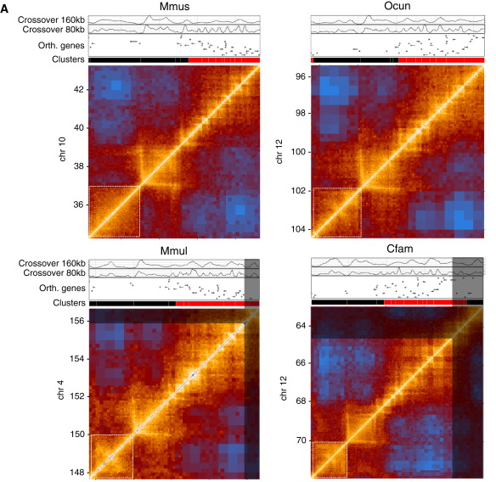
Broad topological-associated domains are largely conserved
Topological domains in mammalian genomes identified by analysis of chromatin interactions
Comparative Hi-C reveals that CTCF underlies
evolution of chromosomal domain architecture
(Dixon, Nature, 2012)
(Rudan, Cell Rep., 2015)

Slide 42
Establishment of chromatin states is mostly driven by sequence specific transcription factors
Shlyueva, 2014

Slide 43
Competition between TFs and nucleosomes
Shlyueva, 2014

Slide 44
TFs direct differential enhancer usage during development
Heinz, 2015
Spitz and Furlong, 2012

Slide 45
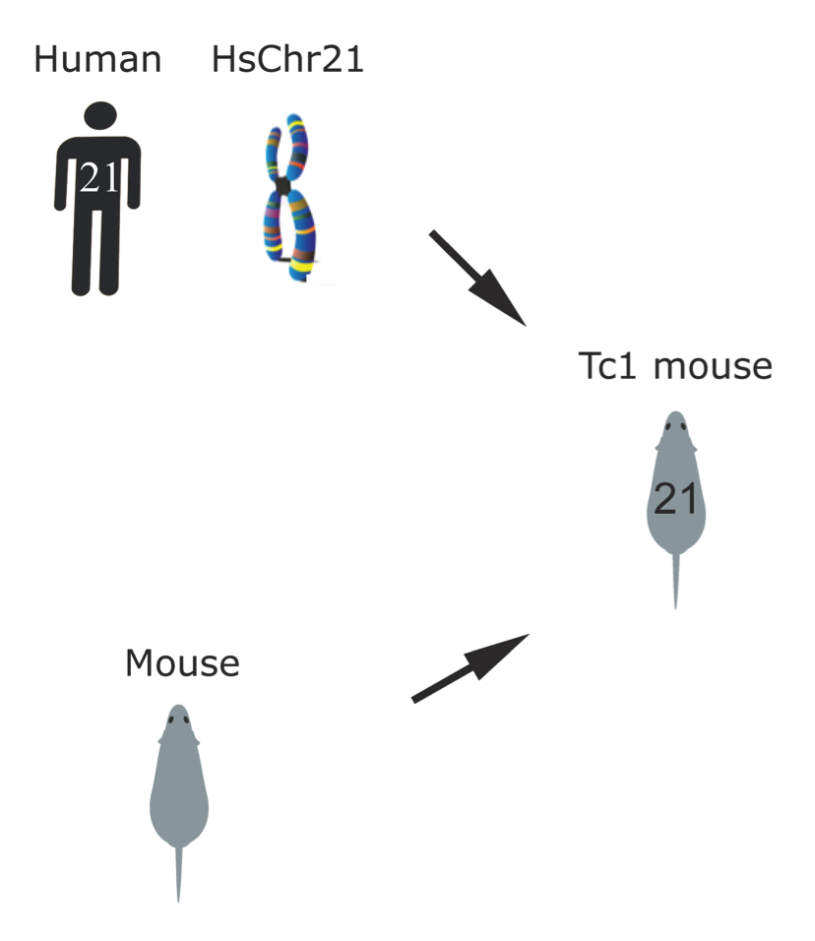
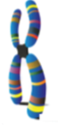
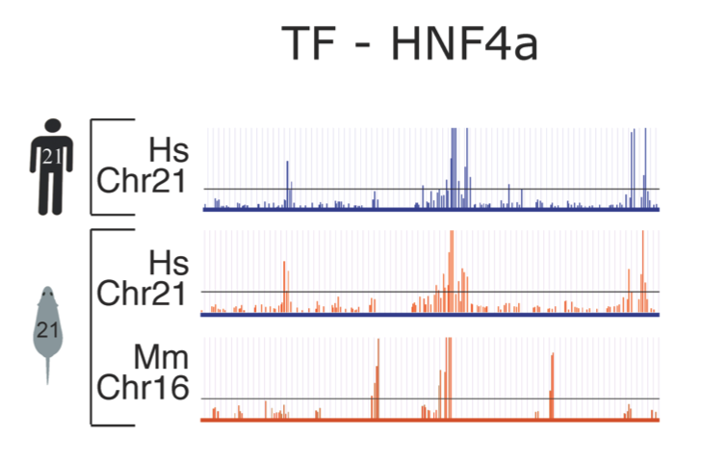
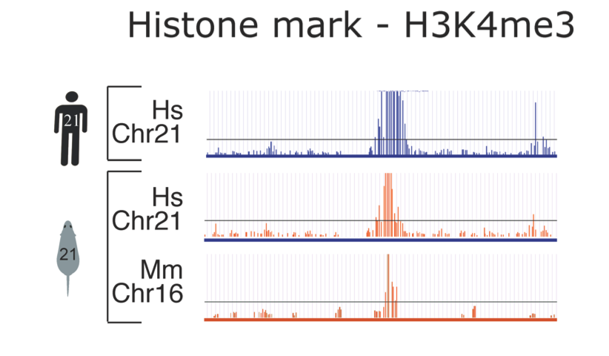
DNA sequence directs TF binding and histone modifications
HsChr21
Human
genome
Mouse
genome
HsChr21
(Wilson/Barbosa-Morais, Science, 2008)

Slide 46
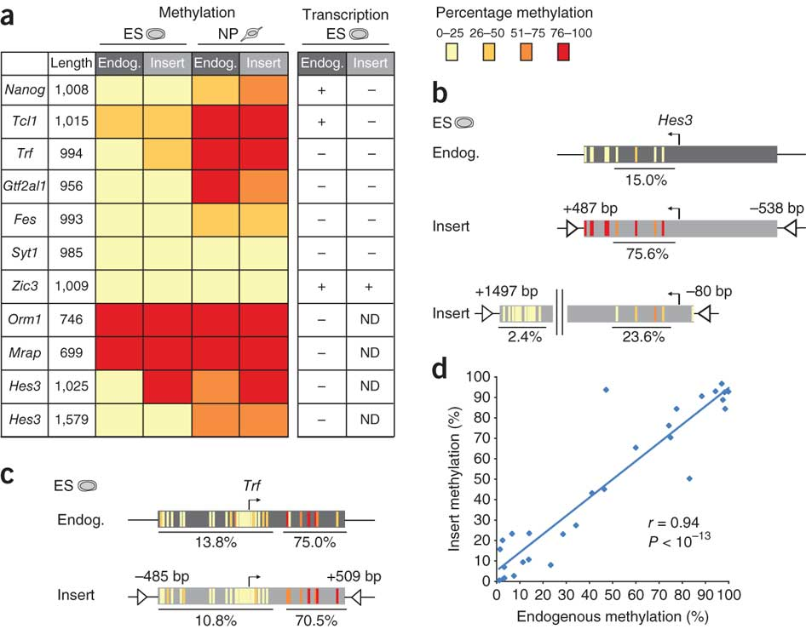
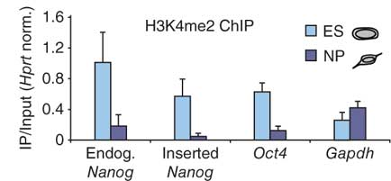
DNA sequence directs histone modifications and DNA methylation
Identification of genetic elements that autonomously determine DNA methylation
(Lienert, Nat. Gen., 2011)

Slide 47
Multiple regulatory layers combine to control transcription
(Markenschlaeger et al. Cell 2013)

